Slide 1
BINARY SEARCH TREE
Group Members:
Tushita Singh (BT16CSE006)
Rinisha Gedam (BT16CSE012)
Prachita Kotangale (BT16CSE018)

Slide 2
PROBLEMS STATEMENT?
ARRAYS:
BINARY TREE:
The problem with a sorted array is that elements can't be inserted and removed efficiently.
The tree is just having two children but no particular order is maintained.But insertion and deletion has become easy.

Slide 3
Solution
But the major function for having a tree was not only for efficient insertion and deletion but also for performing operations like SEARCHING, SORTED ORDER,RANGE-INQUIRY.All in O(logn) mostly
BINARY SEARCH TREE

Slide 4
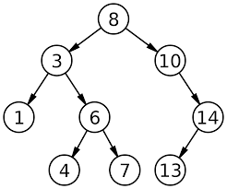
Properties of a Binary Search Tree
All elements kept in the tree are unique
Value (key) of the Left child < Value (key) of the Root
Value (key) of the Root < Value (key) of the Right child

Slide 5
Challenges deep-dive
Insertion
Deletion
Searching
1. Start from root.
2. Compare the inserting element with root, if less than root, then recurse for left, else recurse for right.
3. After reaching end,just insert that node at left(if less than current) else right.
1. Node to be deleted is leaf: Simply remove from the tree.
2. Node to be deleted has only one child: Copy the child to the node and delete the child
3. Node to be deleted has two children: Find inorder successor of the node. Copy contents of the inorder successor to the node and delete the inorder successor. Note that inorder predecessor can also be used.
1. Start from root.
2. Compare the inserting element with root, if less than root, then recurse for left, else recurse for right.
3. If element to search is found anywhere, return true, else return false.

Slide 6
Structure of Node:
DATA
The tree will be implemented using structure of node linked to each other using pointers i.e pointer to Left child and pointer to Right child and data field containing key value.
Left node(child)
Right node(child)

Slide 7
Insertion in BST.
String given: 20, 10, 5, 2, 8, 15, 30, 25, 23, 27, 40, 45.
20
10
30
5
15
25
40
8
23
27
45
2

Slide 8
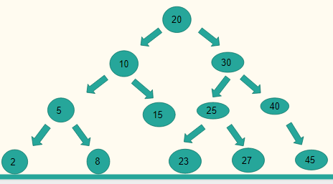
Searching in BST
Search: 27
root=20, less than 27, go RIGHT.
root=30,greater than 27, go LEFT.
root=25, less than 27, go RIGHT.
root=27, equal to 27, STOP.
Return Pointer.

Slide 9
Deletion in BST
Deletion of Leaf Node 9
Deletion of Node with two child Nodes 15
Deletion of Node with single child 2
10
15
6
18
14
1
12
20
2
9
1
30
11
14
18

Slide 10
Range Search in BST
CASE 1 : If key1 > key 2
10
CASE 2 : If key1 < key2
CASE 3 : If key1= key2
6
15
key1 = 2 and key2 = 20
Output : 2 6 9 10 11 12 14 15 18 20
2
9
12
20
1
30
11
14
18
Notes:
For Range Search in BST we ask for two key values from the user
If suppose user inputs 10 and 2 it will raise an error which is our 1st case
For the 2nd case if the inputs by user are 2 and 20 then the output will be as you can see on the screen
The last case is wherein you will have both key values equal so just return any one key value.

Slide 11
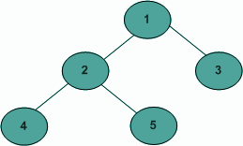
Traversal order :
Depth First Traversals:
(a) Inorder (Left, Root, Right) : 4 2 5 1 3
(b) Preorder (Root, Left, Right) : 1 2 4 5 3
(c) Postorder (Left, Right, Root) : 4 5 2 3 1
Breadth First or Level Order Traversal : 1 2 3 4 5

Slide 12
Sorted order printing of a given array that represents a BST:
6
50
6,12
24
69
6,12,15
6,12,15,24
12
25
6,12,15,24,25
6,12,15,24,25,44
6
15
49
6,12,15,24,25,44,49
44
6,12,15,24,25,44,49,50
6,12,15,24,25,44,49,50,69

Slide 13
Conclusion :
Binary search tree can be used both as a dictionary and as a priority queue.
Basic operations on a binary search tree take time proportional to the height of the tree. For a complete binary tree with n nodes, such operations run in O(lg n)worst-case time.

